Slide 1
Position-Aware Visual Interaction Transformers with Human-Centric Priors
Chunyu Jiang
Supervisor: Prof Chao Chen, Prof Michael Wang
Notes:
"Good afternoon, members of the panel,. My name is Chunyu Jiang, a PhD candidate at Monash university supervised by prof chao chen.
Today, I am pleased to present my progress review presentation titled: 'Position-Aware Visual Interaction Transformers with Human-Centric Priors'.

Slide 2
Outline
Introduction
Literature Review
Research Gap and Aims
Proposed Research
Research Result
Timeline
1

Slide 3
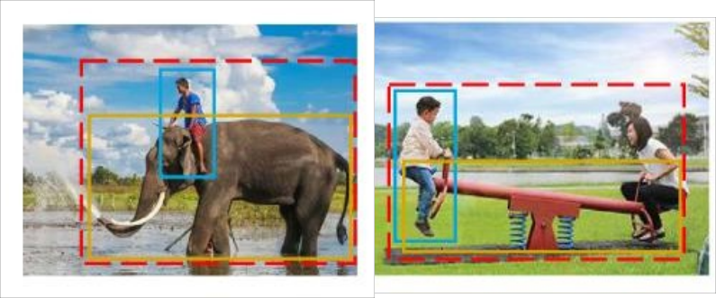
Introduction
Human Object Interaction (HOI)
HOI detection is the process of estimating the interaction between a human and object in an image/video.
For HOI, the result is to predicate the triplet <human, action, object>.
HOI is proposed to answer: “What are the people doing with what objects?”
Fig.1: The red box indicates the area of human-object interaction, while the blue and yellow boxes represent the human and the object, respectively. In the HOI result is “human ride elephant”, and in the right box, is “children play seesaw”
2
Notes:
"To begin, let us define the core focus of this research: Human-Object Interaction, or HOI.
At its heart, HOI detection is the process of estimating and classifying the complex relationships between humans and the objects they interact with in a image.
While standard object detection focuses on what is in an image, HOI aims to answer the more semantic question: 'What are the people doing with what objects?'.
The output of hoi is a structured triplet: <human, action, object>.
Take Figure 1 for example. A simple detector might find a human and an elephant. Our goal is to determine the precise interaction—'human ride elephant'.

Slide 4
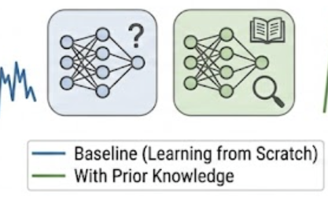

Literature Review
Prior Knowledge
Why it matters:
Data Efficiency: Compensates for limited samples by leveraging geometric constraints and physical laws.
Semantic Anchoring: Bridges the gap between the "Unknown" and the "Known," reducing cognitive and computational load.
Typical Forms:
Spatial Priors: Modeling spatial relationships and relative positioning between objects.
Pre-trained Weights: Transferring feature extraction capabilities from large-scale datasets (e.g., ImageNet, COCO).
Impact:
Accelerated Convergence: Enables faster model training in complex AI tasks.
Enhanced Transferability: Improves the efficiency and robustness of Transfer Learning.
3
Notes:
A central theme of my research is the effective utilization of Prior Knowledge.
Prior knowledge acts as a critical bridge between 'known' and 'unknown' information. By leveraging expertise from one domain and applying it to another, we allow the new model to achieve high performance much faster
One of the most common examples of prior knowledge is using a CNN pre-trained on ImageNet as backbone. this because it provides the most powerful feature extraction capabilities currently available, giving model a 'head start' in understanding visual features."

Slide 5
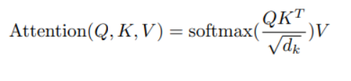
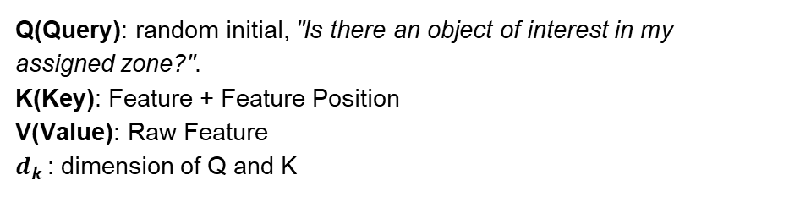
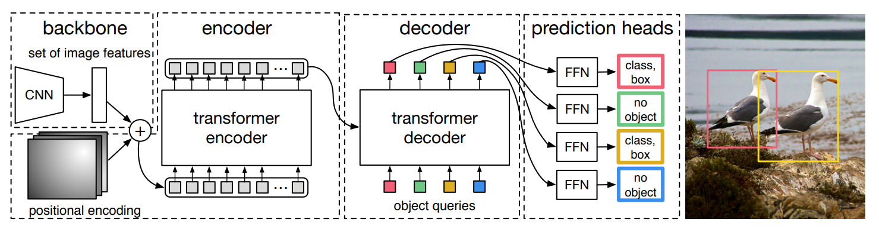
Literature Review
Query in DETR
DEtection TRansformer (DETR)[1], developed by Facebook AI (FAIR), is a pioneering object detection model.
Query functions as a "virtual detective“, they are learnable vectors, initial zero. Interacting with global image features through cross-attention to independently learn through epoch.
Eq. 1：Cross attention equation
Fig.2：DETR structure
4
[1] Carion, Nicolas, et al. "End-to-end object detection with transformers." European conference on computer vision. Cham: Springer International Publishing, 2020.
Notes:
Next, I’d like to focus on the heart of the Detection Transformer, or DETR, which was done by the Facebook AI Research team. DETR represents a fundamental shift in how we approach object detection.
If we look at the formula in the top right, it is the cross attention equation of detr
The Query ($Q$) represents the detective’s question: ‘Is there an object of interest in my assigned zone?’ Initially, these are set to random initial, original detr has 100 query,The Key is feature a feature position and The Value ($V$) is the raw visual information.
Figure 2 is the structure of detr, each query output bbox, classification

Slide 6
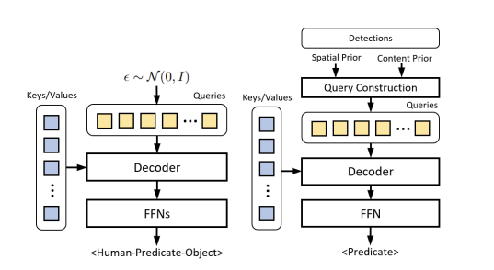
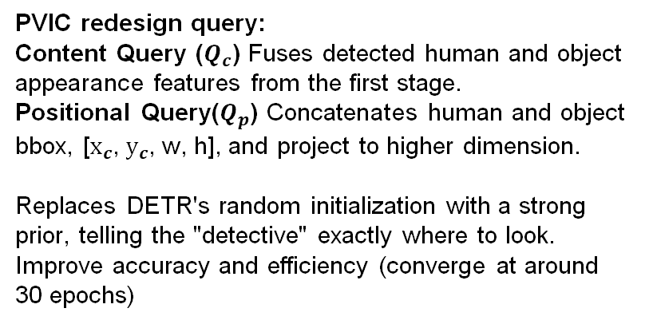
Literature Review
PVIC
A core limitation of the original DETR is that these queries are randomly initialized. They often exceeding 500 epochs to achieve stable convergence and accurate bounding box regression.
Fig. 3：PVIC[2] query design
[2] Zhang, Frederic Z., et al. "Exploring predicate visual context in detecting of human-object interactions." Proceedings of the IEEE/CVF international conference on computer vision. 2023.
5
Notes:
"Now, I want to highlight the PVIC model, which serves as a major baseline and inspiration for my research.
PVIC introduced a significant redesign of the query mechanism. Instead of random vectors, it constructs queries using two specific components:
Content Query ($Q_c$): This fuses the appearance features of the detected human and object from the initial stage.
Positional Query ($Q_p$): This concatenates the human and object position information and projects them into a higher-dimensional space.
By replacing random initialization with this strong prior. This targeted approach not only improves detection accuracy but also enhances training efficiency, allowing the model to converge in only 30 epochs compare with 500 epoch of original detr

Slide 7

Literature Review
Dataset
Sub-optimal Visual Quality: Human instances compromised by extremely small scales, severe occlusions, or inadequate lighting conditions, which results in degraded feature representation.
Incomplete and Non-central Annotations: Annotations sometimes focus on peripheral subjects rather than the primary, most semantically significant interactions in the scene.
Human Error: it contain 3-4% error rates, including misclassified actions and coarse bounding box boundaries.
Feature | V-COCO
Total images | 10,346
Object categories | 80
Action categories | 29
Table.1：Brief review of main HOI dataset
Fig.4：Non-central annotation and small human instance, GT for this picture is <human, ride, boat>
6
Notes:
"Next, I will provide a brief review of the primary benchmarks used in Human-Object Interaction research: V-COCO.
As summarized in Table 1, V-COCO has roughly 10,000 images and 29 action categories. and 80 object categories.
The datasets present three major challenges that my research seeks to address: first is human instance maybe small, or occlusion. Next is annotation focus on edge subject than primary, last is human error
We can see a clear example of these challenges in Figure 3. While the ground truth for this image is the triplet <human, ride, boat>, the human instances are extremely small and positioned away from the center of the frame.

Slide 8
Research Gap and Aims
HOI models struggle with efficient feature extraction, leading to ambiguous intent recognition and inefficient feature utilization. To implement a Position-Aware framework that optimizes feature isolation to clarify agent intent .
Established datasets contain significant noise, with error rates, This low-fidelity input causes models to learn incorrect patterns rather than genuine physical interactions. To implement a Data Quality Refinement strategy that purifies the dataset.
Current methods use coarse bounding boxes, lacking fine-grained human-centric priors (posture, gaze) necessary for disambiguating complex relationships. To incorporate Human Structural Priors into the query design process to provide the model with a high-resolution understanding of the agent
7

Slide 9

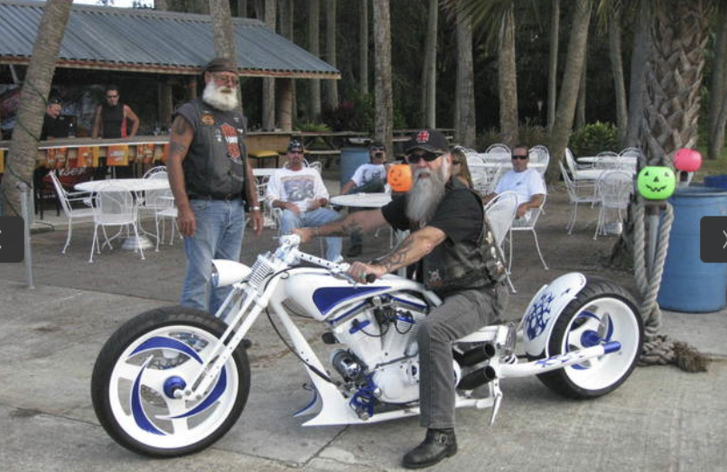
Proposed Research
Human-center dataset
1
Impact on Model
Suboptimal Feature Learning: Leads to poor generalization across diverse scenarios.
Overfitting Risk: High data noise increases the likelihood of the model memorizing artifacts instead of learning patterns.
Proposed Solution
  Leverage Off-the-shelf Detectors: Implement pre-trained human detection model RTMPose-L, SOTA frameworks to ground the search space.
Data Quality Refinement: Apply a strict 80% confidence threshold to filter and retain only high-fidelity samples.
Result
Train and valid: from 5,814 to 5,404
Test: From 4,532 to 4,332
2
Fig.5：Example 1 was discarded since human detection confidence score (32%) is below the 80% threshold. Example 2 keeped
8
Notes:
We know the dataset’s problem, so to To overcome these barriers, I have implemented a refine statety:
Leveraging Off-the-shelf Detectors: I utilize the state-of-the-art RTMPose-L human detection model to ground our search space and provide a reliable baseline for human localization.
Data Quality Refinement: I apply a strict 80% confidence threshold to all detections.

Slide 10









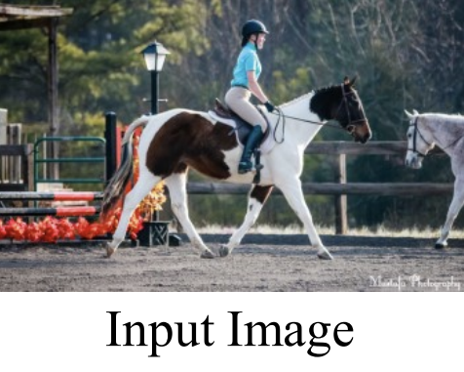
Flow Chart
Detection
Query Feature Enhancement
Object
bbox
Human Object matcher
Encoder
Face Direction
Human bbox
Query
Key
Value
Query Position Enhancement
CNN
Position
Dynamic Fusion
Decoder
Object
bbox
MLP
< Human Ride Horse>
Skeletion detection
Dynamic
Keypoints selection
MLP
9
Notes:
Now, I would like to walk you through the architecture of my proposed framework.
First, is the standard routine, The input image passes through a CNN backbone to extract raw visual, then go to Transformer Encoder to produce a global image feature map, which we denote as $V_e$ .
Then is The core innovation of my work, I have two parallel query enhancement unit:
Query Feature Enhancement (Yellow Box): We utilize a detection module on $V_e$ to identify the Object bounding box, Human bounding box, and a novel prior—Face Direction . These inputs are fed into the Human-Object Matcher, to output $ho\_q$.
Query Position Enhancement (Blue Box): Simultaneously, we perform Skeleton Detection and Dynamic Keypoints Selection directly from the input . These keypoints are processed through an MLP and combined with the Object bbox information in the Position Dynamic Fusion module. To generate, $q\_pos$.
3. Decoder Interaction and Output: These two enhanced components form our final Query

Slide 11


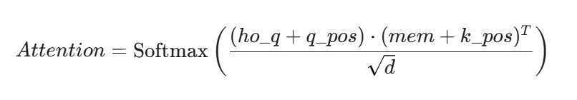





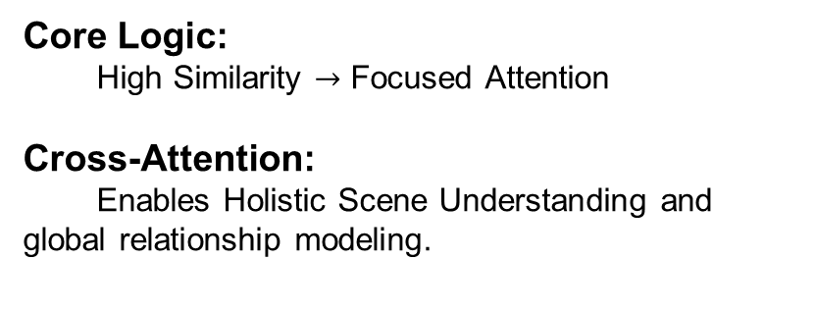
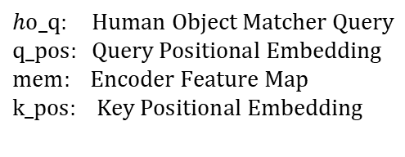
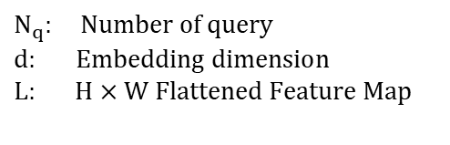
Proposed Research
Query Mathematic theory
Eq. 1：Cross attention equation
Eq. 3：Decomposition of the Scaled Dot-Product Attention Score. This expansion why spatial information matters
Eq. 2：Cross attention math equation, softmax outputs represent the spatial attention distribution of each query over the entire image
10
Notes:
Core Logic:
High Similarity → Focused Attention
Cross-Attention:
Enables Holistic Scene Understanding and global relationship modeling.
Dot-Product Similarity:
Measures the geometric proximity between Query and Key in high-dimensional space.
Spatial-Semantic Alignment:
Elevated attention weights signify a convergence between spatial priors (expectations) and visual evidence (features), directing the model to concentrate on task-relevant regions.

Slide 12
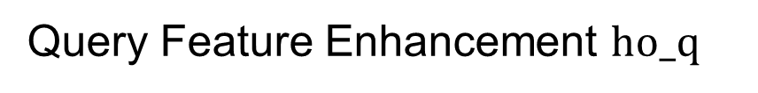


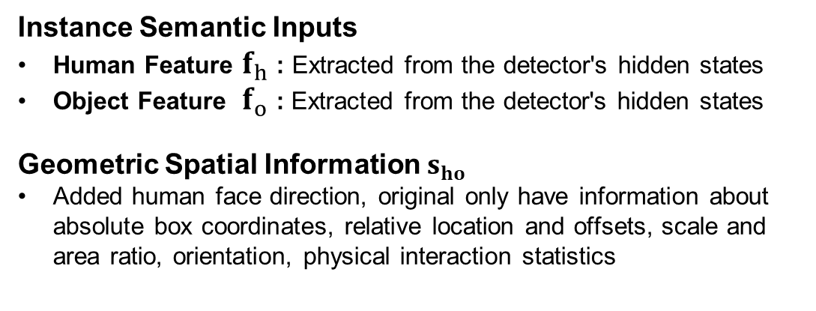
Proposed Research
11
Notes:
"Moving into Query feature enhancement, As shown in Equation 4, $ho\_q$ is constructed by concatenating semantic and geometric information, and then project into 512 dimension for later dot product
The inputs for this query are divided into two primary categories:
Instance Semantic Inputs: We extract high-level semantic features for both the human and the object directly from the hidden states of our detector. This provides the 'content' context—telling the model what the entities in the scene are.
Geometric Spatial Information ($\mathbf{s}_{ho this one have human face direction - as a key human centered spatial prior, box coordinates, relative offsets, scale ratios
By adding face direction to the existing spatial features, we provide the model with a much stronger cue regarding the human's point of interest and intent. This additional prior is crucial for disambiguating complex interactions, especially in scenes where a human might be surrounded by multiple objects but is only interacting with one specific target."

Slide 13

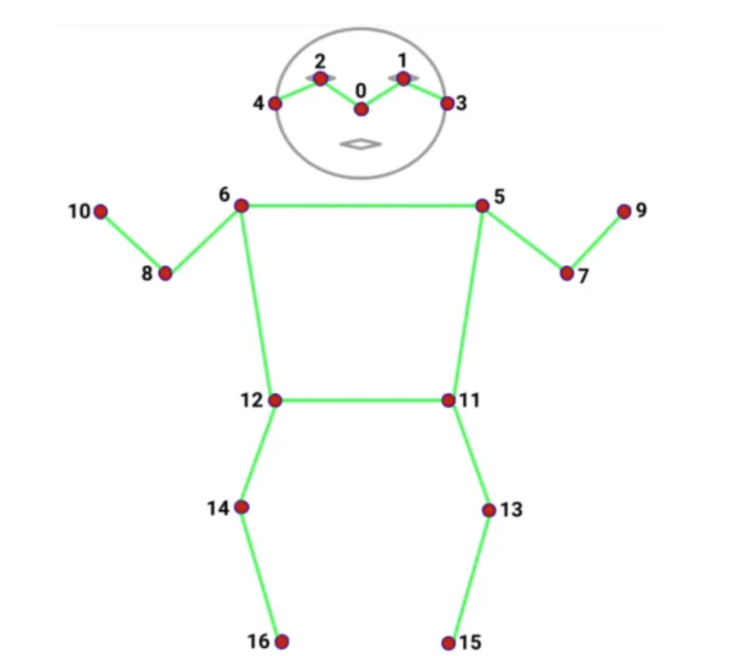
Proposed Research
Added Object position information and human position information
Object position information use center of bounding box
Human position information use human keypoints
q_pos dimension is same as ho_q (512), Use MLP raise dimonson of position information and then concatenate. Also test how many keypoints input and the dimension arrangement influence the model
The keypoints I choose is:
6 kpts : face, hand , feet, midpoint shoulder
17 kpts: 17 standard keypoints
23 kpts: 17 keypoints and 6 midpoint
31 kpts: 17 keypoints and 14 midpoint
Ratio means skeleton keypoints Dimension /object center Dimension:
Ratio 1: skeleton and object all 256
Ratio 3: skeleton 384 object 128
Variable: number of keypoints / object point, for example, 6 keypoint variable ratio is 438:74
Fig.6：17 coco human skeleton keypoints
12
Notes:
Core Logic:
High Similarity → Focused Attention
Cross-Attention:
Enables Holistic Scene Understanding and global relationship modeling.
Dot-Product Similarity:
Measures the geometric proximity between Query and Key in high-dimensional space.
Spatial-Semantic Alignment:
Elevated attention weights signify a convergence between spatial priors (expectations) and visual evidence (features), directing the model to concentrate on task-relevant regions.

Slide 14
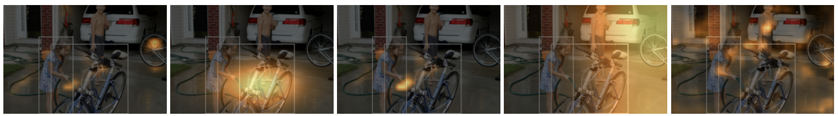
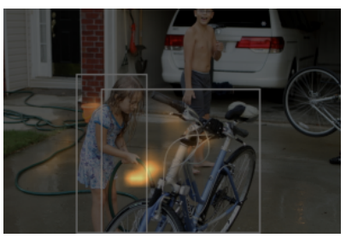
Research Result
Model Attention
1
2
5
3
4
13
Notes:
“now I want to present some qualitative evidence. This slide visualizes the Attention Weights generated by our framework, specifically showing how the mathematical decomposition we discussed earlier translates into actual scene understanding .
Looking at Figure 5, we have broken down the attention mechanism into its individual components based on our expanded equation:
Image 1 ($ho\_q \cdot mem^T$): This represents the attention derived purely from content features. While the model recognizes the child and the bicycle, the attention is somewhat broad and can be distracted by other semantic features in the background .
Image 2 ($q\_pos \cdot k\_pos^T$): This shows the influence of positional embeddings. Here, the model uses our enhanced keypoint priors to establish a geometric zone of interest.
Images 3 & 4: These represent the cross-terms
Image 5: This is the final concatenated formulation. You can clearly see that when all components are combined, the attention becomes significantly more focused and precise.
This means our model can focus right on the interaction position, help model to understand

Slide 15
Research Result
Results
Table. 1: Ablation Study based on refined V-COCO dataset
14
Notes:
Moving on to the quantitative analysis, I conducted a systematic ablation study to evaluate the performance of our proposed enhancements. Here, the PVIC model serves as our competitive baseline, providing a benchmark. We have 5 model out performance than pvic and the largest increase 0.4 percent
As we examine the X-axis, a clear trend emerges regarding keypoint density. Performance improves steadily as we move from 6 to 17 keypoints, where the model reaches its peak performance—nearly hitting the 64 mAP mark. However, as we further increase the density to 23 and 31 keypoints, we observe a notable deterioration effect. This suggests that 17 points provide the optimal balance of structural information. Beyond this threshold, higher densities appear to introduce redundant features or localization noise that interferes with the Transformer’s attention mechanism, rather than providing additional discriminative power
We also investigated the impact of our dimension allocation strategies. Interestingly, for the sparse 6-keypoint configuration, Ratio 3—which allocates more dimensions to the skeleton—performed slightly better than Ratio 1.However, as the number of keypoints increased, we observed a general decrease in performance as the ratio rose. This leads us to a key hypothesis regarding embedding capacity: given that the total dimension of $q_{pos}$ is fixed at 512, a higher ratio for a large number of points means each individual point receives fewer dimensions. Consequently, the MLP projection may lack the necessary 'bandwidth' to sufficiently cover and encode fine-grained positional details into the high-dimensional vector.

Slide 16
Research Result
Results
 |  | HICO-DET |  |  |  | V-COCO
 |  | Default setting
Method | Backbone | Full | Rare | Non-rare |  | mAP
InteractNet | ResNet-50-FPN | 9.94 | 7.16 | 10.77 |  | 40
GPNN | ResNet-101 | 13.11 | 9.34 | 14.23 |  | 44
iCAN | ResNet-50 | 14.84 | 10.45 | 16.15 |  | 45.3
TIN | ResNet-50 | 17.03 | 13.42 | 18.11 |  | 47.8
VSGNet | RetNet-152 | 19.8 | 16.05 | 20.91 |  | 51.8
PPDM | Hourglass-104 | 21.94 | 13.97 | 24.32
VCL | ResNet-50 | 23.63 | 17.21 | 25.55 |  | 48.3
DRG | ResNet-50-FPN | 24.53 | 19.47 | 26.04 |  | 51
IDN | ResNet-50 | 24.58 | 20.33 | 25.86 |  | 53.3
HOTR | ResNet-50 | 25.1 | 17.34 | 27.42 |  | 55.2
FCL | ResNet-50 | 25.27 | 20.57 | 26.67 |  | 52.4
HOI-Trans | ResNet-101 | 26.61 | 19.15 | 28.84 |  | 52.9
AS-Net | ResNet-50 | 28.87 | 24.25 | 30.25 |  | 53.9
SCG | ResNet-50-FPN | 29.26 | 24.61 | 30.65 |  | 54.2
QPIC | ResNet-101 | 29.9 | 23.92 | 31.69 |  | 58.8
CDN | ResNet-101 | 32.07 | 27.19 | 33.53 |  | 63.9
UPT | ResNet-101-DC5 | 32.62 | 28.62 | 33.81 |  | 61.3
RLIP | ResNet-50 | 32.84 | 26.85 | 34.63 |  | 61.9
GEN-VLKT | ResNet-50 | 33.75 | 29.25 | 35.1 |  | 62.4
PVIC | ResNet-50 | 34.69 | 32.14 | 35.45 |  | 62.8
Ours-17-ratio1 | ResNet-50 | 34.86 | 31.92 | 36.15 |  | 62.95
15
Table. 2: Performance comparison in original V-COCO and HICO-DET dataset with other Model
Notes:
"Moving to the quantitative evaluation of our framework, I would like to present the benchmarking results as summarized in this table. We have compared our proposed method against a wide range of established HOI detection frameworks—from early models like InteractNet to the current state-of-the-art PVIC.
1. Performance on HICO-DET: On the HICO-DET dataset, using a standard ResNet-50 backbone, our method achieves a competitive 34.86 mAP on the 'Full' category . This represents an improvement over the 34.69 mAP achieved by the PVIC baseline .
If we look at the specific sub-categories, our framework shows its strongest performance in the 'Non-rare' interaction set, reaching 36.15 mAP. This is a notable increase from PVIC’s 35.45 mAP and suggests that our position-aware priors are particularly effective at resolving common, yet complex, human-object relationships.
2. Performance on V-COCO: Furthermore, on the V-COCO benchmark, our model reached a mAP of 62.95. This continues the trend of outperforming the PVIC baseline
Conclusion of Results: These numbers demonstrate that by replacing random query initialization with fine-grained human-centric priors—specifically 17 skeleton keypoints and face direction—we can consistently improve detection accuracy across different benchmarks .

Slide 17
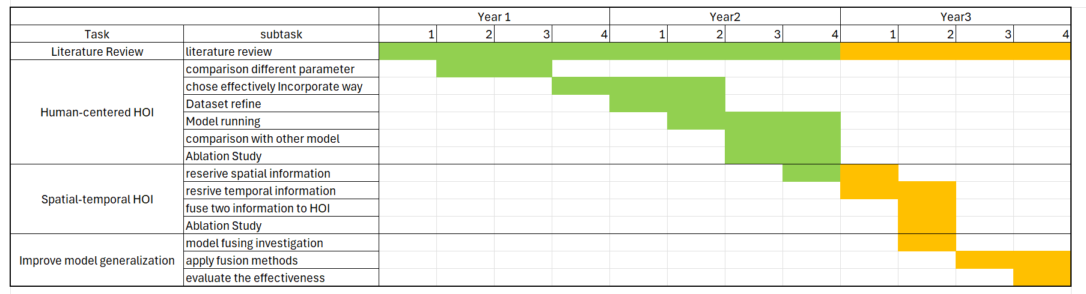
Timeline
Name | Journal | Condition
Position-Aware Visual Interaction Transformers with Human-Centric Priors | IEEE Transactions on Artificial Intelligence | Draft
Learning Human-Centric Interaction Evolution in Video Sequences via Temporal Transformers | IEEE Transactions on Artificial Intelligence
Occlusion-Robust Human Object Detection Detection via Pose-Guided Feature Completion | (IEEE International Conference on Image Processing
16
Notes:
The structure

Slide 18
Thanks

